Slide 1
Bird Species Observation Analysis Across Forest and Grassland Ecosystems

Slide 2
CONTENTS
Executive Summary
Objective
Dataset Overview
Problem Statement
Data Preparation & Cleaning
Analysis Performed
Key Performance Indicators (KPIs)
Dashboard Visualizations
Insights & Findings
Business Recommendations
Conclusion

Slide 3
EXECUTIVE SUMMARY
This project presents an analytical study of bird species observations across forest and grassland habitats. The analysis focuses on understanding biodiversity, environmental impact, and species behavior. The dashboard provides insights into species distribution, habitat comparison, and environmental influences, helping support data-driven decisions for conservation and ecosystem management.

Slide 4
OBJECTIVE
The main objectives of this project are:
To analyze bird species distribution across forest and grassland habitats
To compare biodiversity levels between different ecosystems
To understand the effect of environmental factors such as temperature, humidity, wind, and sky conditions
To study temporal trends like seasonal and yearly patterns
To build an interactive dashboard for better decision-making

Slide 5
PROBLEM STATEMENT
Bird observation data is large and complex, making it difficult to extract meaningful insights manually.
Without proper analysis:
It is hard to identify biodiversity-rich areas
Environmental impacts on bird activity are unclear
Species behavior patterns are not easily visible
Raw data cannot support decision-making
Therefore, there is a need for structured data analysis and visualization to transform raw data into actionable insights.

Slide 6
DATASET OVERVIEW
The dataset contains bird observation records collected from multiple forest and grassland locations.
Key Attributes:
Species Information: Common_Name, Scientific_Name
Location Details: Admin_Unit_Code, Site_Name, Plot_Name
Temporal Data: Date, Year, Start_Time, End_Time
Environmental Factors: Temperature, Humidity, Sky, Wind
Behavioral Data: Observation_Method (ID_Method), Distance, Flyover
Additional Information: Sex, Observer, Visit

Slide 7
DATA PREPARATION & CLEANING
Before analysis, the data was cleaned and processed:
Removed duplicate records to avoid incorrect counts
Handled missing values using appropriate techniques
Converted columns (Date, Temperature, Humidity) into proper formats
Standardized text columns for consistency
Combined multiple sheets into a single dataset

Slide 8
ANALYSIS PERFORMED
The performance analysis evaluates how bird species observations vary across different habitats, environmental conditions, locations, and time periods. It helps measure biodiversity richness, observation efficiency, and environmental influence on bird activity.

Slide 9
Habitat Performance Analysis
The comparison between forest and grassland habitats shows clear differences in biodiversity and observation counts.
Forest habitats demonstrate higher performance in terms of:
Total observations
Species diversity
Environmental suitability
Grassland habitats show:
Lower observation counts
Fewer species
Presence of specialized species adapted to open areas

Slide 10
Species Performance Analysis
Species performance is evaluated based on frequency of observations.
Certain species appear more frequently, indicating:
High adaptability
Strong habitat preference
Some species are rare or less observed, which may indicate:
Limited population
Specific habitat requirements

Slide 11
Location Performance Analysis
Different observation sites show varying levels of bird activity.
High-performing locations:
Large number of observations
High species diversity
Low-performing locations:
Fewer observations
Limited species presence

Slide 12
Environmental Performance Analysis
Environmental factors significantly influence bird observations.
Temperature:
Optimal range (20–30°C) shows highest activity
Humidity:
Moderate to high humidity supports bird presence
Wind:
Calm conditions increase visibility and detection
Sky conditions:
Clear or slightly cloudy skies lead to more observations

Slide 13
Behavior Performance Analysis
Bird detection methods provide insights into behavior.
Singing → Most common detection method
Calling → Second highest
Visual observation → Less frequent

Slide 14
Dashboard Overview & Key Performance Indicators
The dashboard provides a quick overview of bird species observations using key performance indicators and visualizations. It highlights total observations, unique species count, habitat comparison, and environmental conditions such as temperature and humidity. The visualizations help analyze species distribution, temporal trends, location patterns, and behavioral insights, making it easier to understand biodiversity differences between forest and grassland habitats.

Slide 15
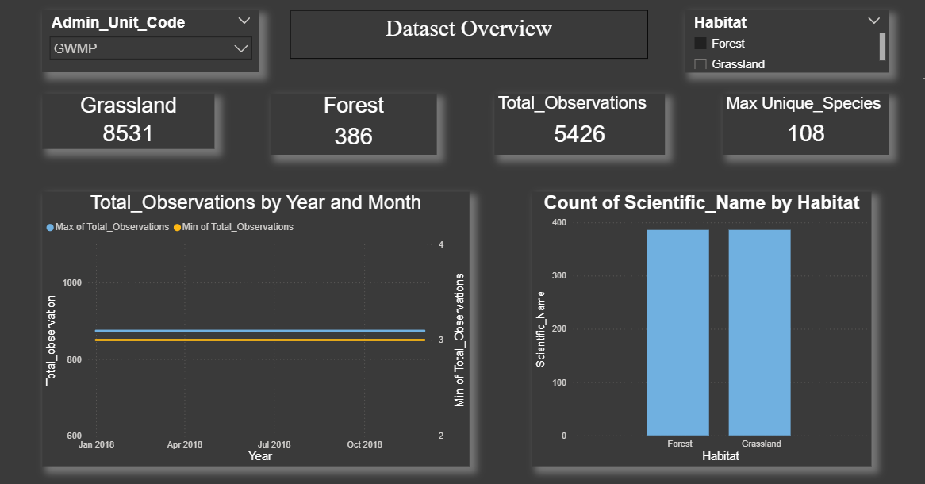
DATASET OVERVIEW DASHBOARD

Slide 16
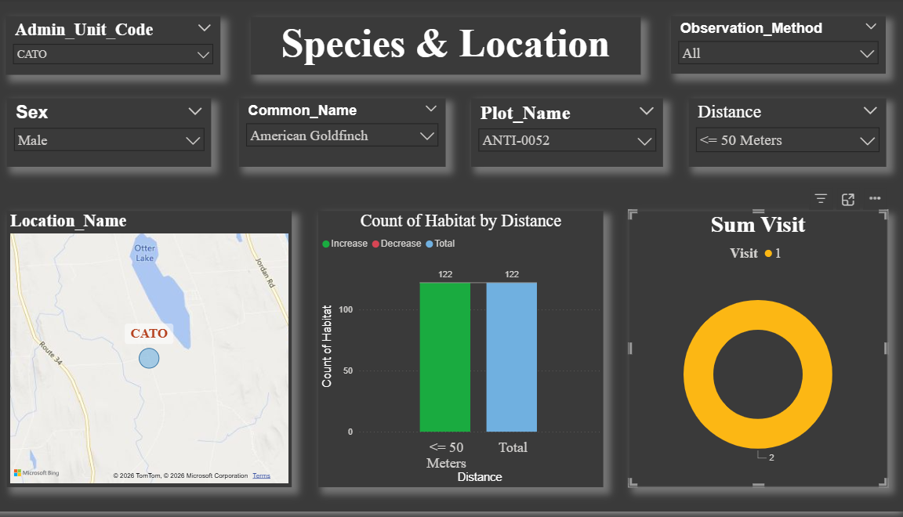
SPECIEUS AND LOCATION

Slide 17
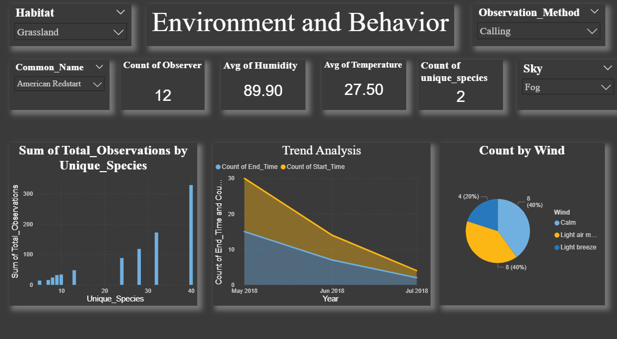
ENVIRONMENT AND BEHAVIOR

Slide 18
INSIGHTS & FINDINGS
Key findings from the analysis:
Forest habitats have higher species diversity due to favorable conditions
Grasslands support fewer but specialized species
Bird activity is highest during moderate temperature (20–30°C)
Seasonal patterns show peak activity in spring
Singing is the most common observation method
Some locations act as biodiversity hotspots

Slide 19
BUSINESS RECOMMENDATIONS
Based on insights:
Focus conservation efforts on high biodiversity forest areas
Protect and monitor identified hotspots
Use environmental conditions for habitat planning
Promote eco-tourism in bird-rich areas
Improve monitoring techniques in grasslands

Slide 20
CONCLUSION
The analysis demonstrates that forest ecosystems support greater biodiversity compared to grasslands. Environmental factors such as temperature, humidity, and weather conditions significantly influence bird activity. Temporal patterns also play a key role in bird observations. The project successfully transforms raw data into meaningful insights that support ecological conservation and decision-making.

Slide 21
Thank you

